Slide 1
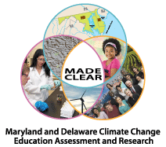
MADE-CLEAR CCEP Grant
J. Randy McGinnis and Chris McDonald
University of Maryland

Slide 2
The Context for Climate Change Education

Slide 3
Sensitive Topic Definition
“Issues that deeply divide a society, that generate conflicting explanations and solutions based on alternative value systems, are considered controversial [sensitive]” (Harwood & Hahn, 1990).

Slide 4
Identified Earth System Sensitive Topics in Science Education (USA)
NESTA Survey of Earth and Space Science Teachers about Needs/Concerns
Sensitive Topic | % Feeling Difficulty or Pressure from Parents, Students, Administrators, or Other Community Members
Evolution | 68%
Age of the Earth | 47%
Climate Change | 43%
Solar System Formation | 22%
Planetary Formation | 13%
There were 275 respondents to this survey (Johnson, 2011).

Slide 5
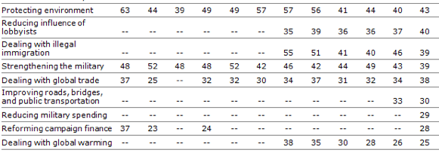
PEW Survey on Public Attitudes in USA (1/11-16/2012)
+18
+25
-14
-13

Slide 6
Teaching Strategies for Sensitive Topics
“The formulation of evidence in support of knowledge claims is central to scientific practice and has been identified as a pedagogically inventive way to engage students in meaningful discussions related to controversial scientific issues such as global climate change” (Schwizer & Kelly, 2005, p. 75).
Begin by teaching relevant science content, then discuss related policy or economic issues, and end by having students explore their own personal stances (Kirk, 2011).
Invite guest speakers to come and speak (McGinnis & Simmons, 1999).

Slide 7
MADE-CLEAR RESEARCH

Slide 8
MADE-CLEAR Project Research Prospectus
A focus on teachers learning how to teach climate change to their students guided by the Common Core (defined by the Next Generation Science Standards, once approved).
Research guided by theory (learning progressions with a socioscientific issues perspective¹).
¹ A socioscientific issues perspective adds a personally and socially relevant approach to learning progressions.

Slide 9
MADE-CLEAR Project Research Prospectus
Goal: Embed climate change science into formal and informal education in the region.
Objective: Advance learning sciences research in the areas of conceptual change and learning progressions to create new understandings of how students from diverse backgrounds engage in learning about climate change.
Assessments will draw on students experience and make student thinking visible, which will improve instructional interventions (see Smith et al., 2004) .

Slide 10
MADE-CLEAR Project Research Prospectus
Goal: Embed climate change science into formal and informal education in the region.
Objective: Assess new approaches to professional development (PD) that foster changes in teacher knowledge, skills, and dispositions through inquiry and the exploration of the relationships of science and technology to society.
Assess outcomes of PD activities that incorporate learning sciences principles and climate change science through quasi-experimental design, case studies, and survey research.

Slide 11
LEARNING PROGRESSIONS

Slide 12
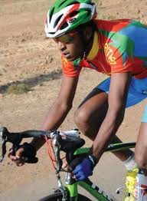
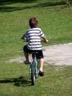
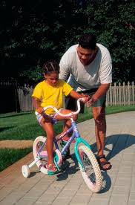
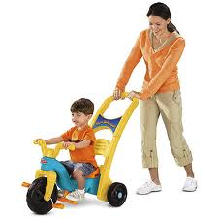
Learning Progressions
More advanced understanding over time

Slide 13
Definition of Learning Progressions
“Learning progressions are descriptions of the successively more sophisticated ways of thinking about a topic that can follow one another as children learn about and investigate a topic over a broad span of time (e.g. 6 to 8 years). They are crucially dependent on instructional practices if they are to occur” (National Research Council, 2007, p. 214).

Slide 14
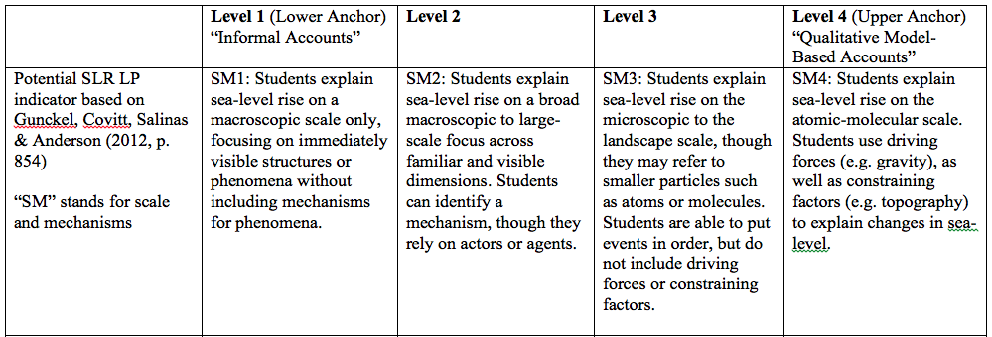
Example: Sea-Level Rise

Slide 15
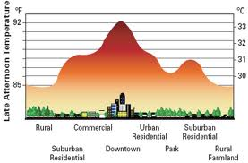
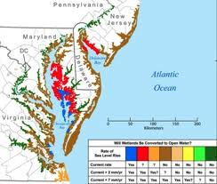
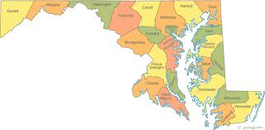
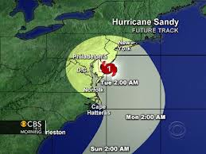
Three Climate Change Learning Progressions
Urban Heat Island Effect
Sea-Level Rise
Extreme Weather

Slide 16
Research Goals with Learning Progressions
To investigate:
how teaching a particular climate change impact helps students in a particular geographic region to learn about climate change science.
how teachers can use these learning progressions to teach about climate change science.
growth over time of students’ knowledge of climate change.

Slide 17
References
DeBoer, G. E. (1991). A History of Ideas in Science Education: Implications for Practice. New York: Teachers College Press.
Gunckel, K. L., Covitt, B. A., Salinas, I., & Anderson, C. W. (2012). A learning progression for water in socio-ecological systems. Journal of Research in Science Teaching, 49(7), 843-868.
Harwood, A. M. & Hahn, C. L. (1990). Controversial issues in the classroom. Bloomington, IN: Eric Clearinghouse for Social Studies/Social Science Education. Retrieved from Eric database. (ED327453) Education, 33(8), 1131-1148.
Johnson, R. (2011). An aside about controversial topics in the earth science classroom – new climate change education survey. Retrieved from http://www.nestanet.org/cms/content/publications/enews/issue/2011/8
Kirk, K. (2011). Teaching environmental issues and the affective domain. Retrieved from http://serc.carleton.edu/NAGTWorkshops/affective/environment.html

Slide 18
References
McGinnis, J. R., & and Simmons, P. (1999). Teachers' perspectives of teaching science-technology-society in local cultures: A sociocultural analysis. Science Education, 83(2), 179-212.
National Research Council. (2007). Taking science to school: Learning and teaching science in grades K-8. Committee on Science Learning, Kindergarten Through Eighth Grade. R. A. Duschl, H. A. Schweingruber, and A. W. Shouse (Eds.). Washington, D.C.: The National Academies Press.
Smith, C., Wiser, M., Anderson, C. W., Krajcik, J., and Coppola, B. (2004). Implications of research on children’s learning for assessment: Matter and atomic molecular theory. Invited paper for the National Research Council committee on Test Design for K-12 Science Achievement. Washington, D.C.: National Research Council.
Schwizer, D. M. & Kelly, G. J. (2005). An investigation of student engagement in a global warming debate. Journal of Geoscience Education, 53(1), 75-84.
Svihla, V. & Linn, M. C. (2012). A design-based approach to fostering understanding of global climate change. International Journal of Science Education, 34(5), 651-676.
Swarat, S., Ortony, A., & Revelle, W. (2012). Activity matters: Understanding student interest in school science. Journal of Research in Science Teaching, 49(4), 515-537.

Slide 19
NSF Disclaimer
This material is based upon work supported by the National Science Foundation under Grant No. 1043262. Any opinions, findings, and conclusions or recommendations expressed in this material are those of the author(s) and do not necessarily reflect the views of the National Science Foundation.

